Slide 1
Media & Reader Bias on Covid-19 Vaccines
Christian Alfonso, Aritra Chowdhury, Rushiil Deshmukh, Akshat Johari, Troy Richard
Analytics for Unstructured Data
Notes:
Good morning everyone, we are Christian, Aritra, Rushiil, Akshat, and Troy and today we are going to discuss media and reader bias.

Slide 2
News Publications:
Which are Biased &
Which are Readers Biased Against?
Notes:
News sources in America are free to report any information they feel readers would want to consume, and they can insert as much or as little bias in their writing as they feel. Americans also tend to consume news from sources whose biases they view are aligned with their political leaning; for example a far-left reader might choose Huffington Post as their publication of choice, whereas a far-right reader might choose Breitbart.
However, are readers’ political biases actually aligning with the published biases of a news source? That is what this study will attempt to address.

Slide 3
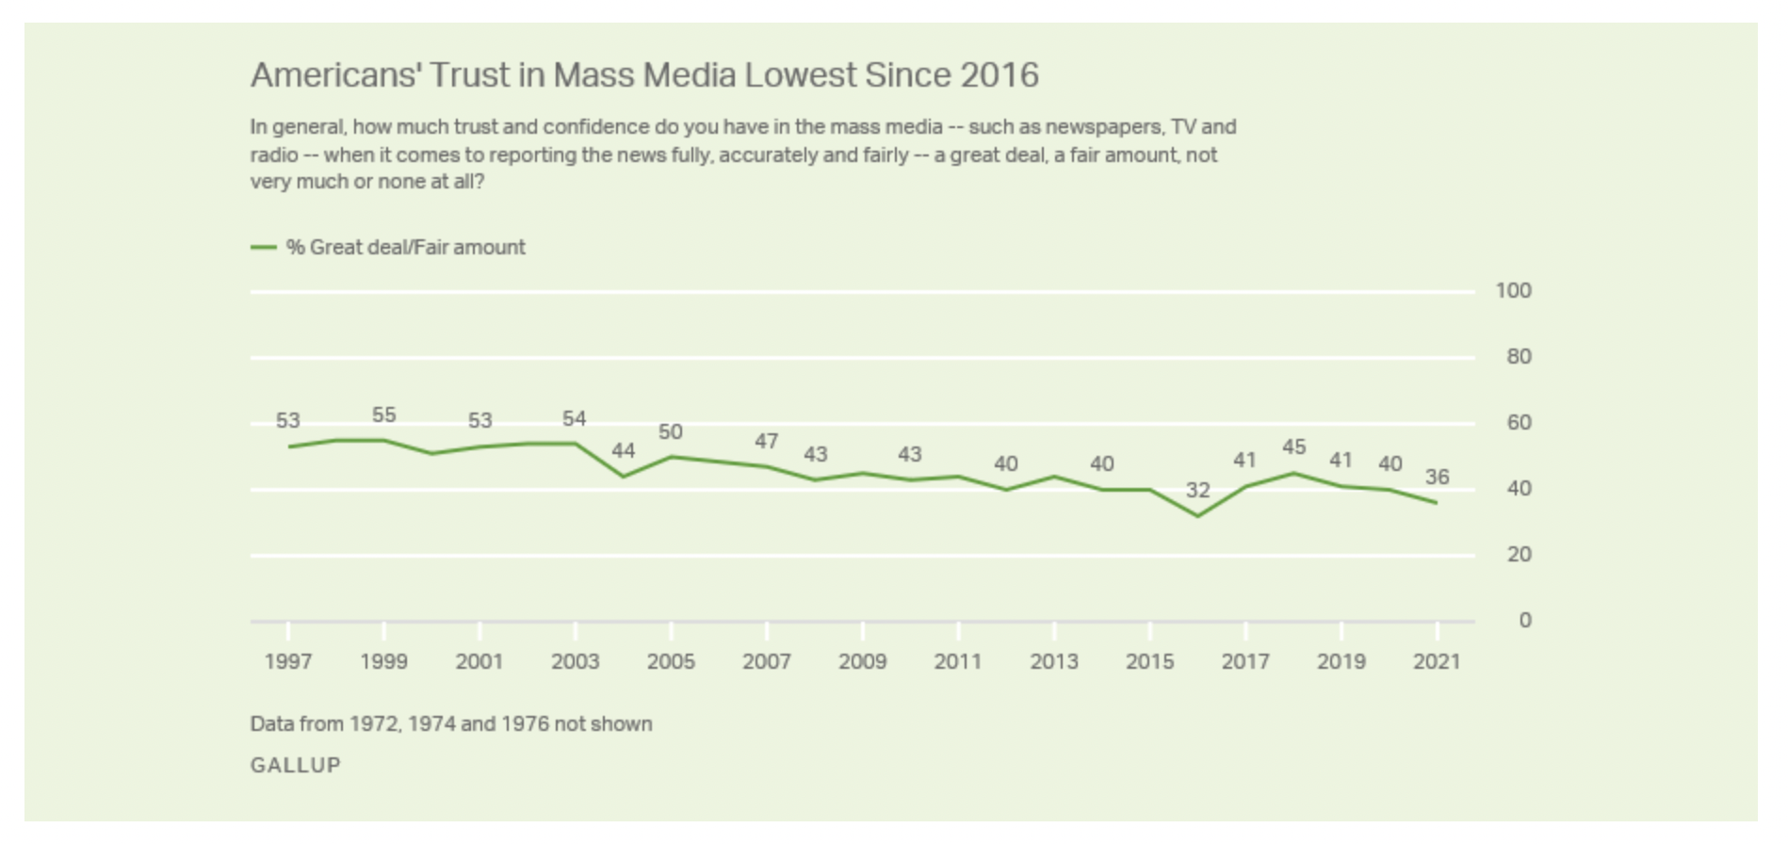
Why Determine the Source of Bias?
Source: Gallup (Published 10/07/21)
Notes:
A recent Gallup poll reported that only 36% of Americans have a great or fair amount of trust of media sources, the second lowest figure on record.
Are there specific publications that are guilty of implanting bias in their reporting, or is it all media sources? If there are specific offenders, are Americans recognizing these biases or are they showcasing this mistrust on the wrong publications due to individual political bias given a perceived political leaning of a news source?

Slide 4



Steps Taken
Scraping
Analysis
Insights

Slide 5
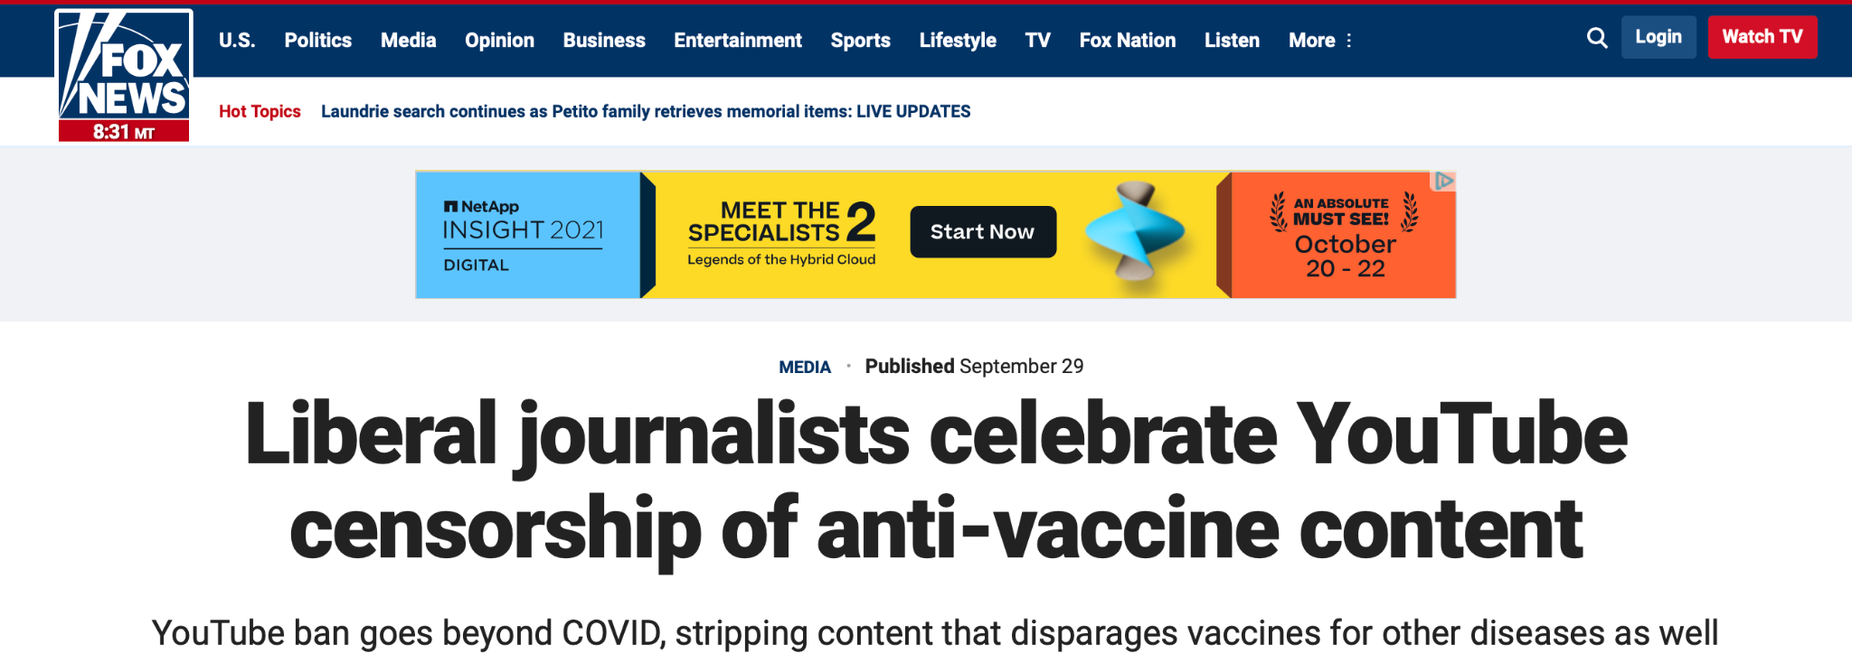
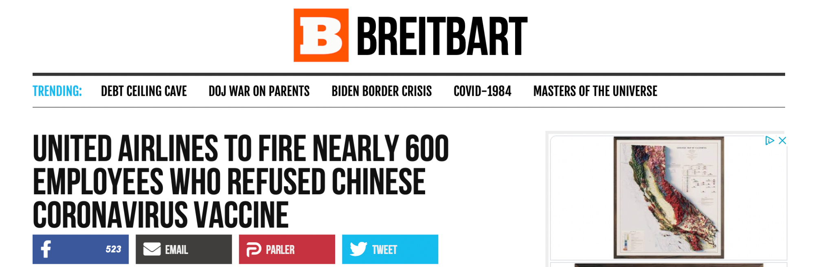
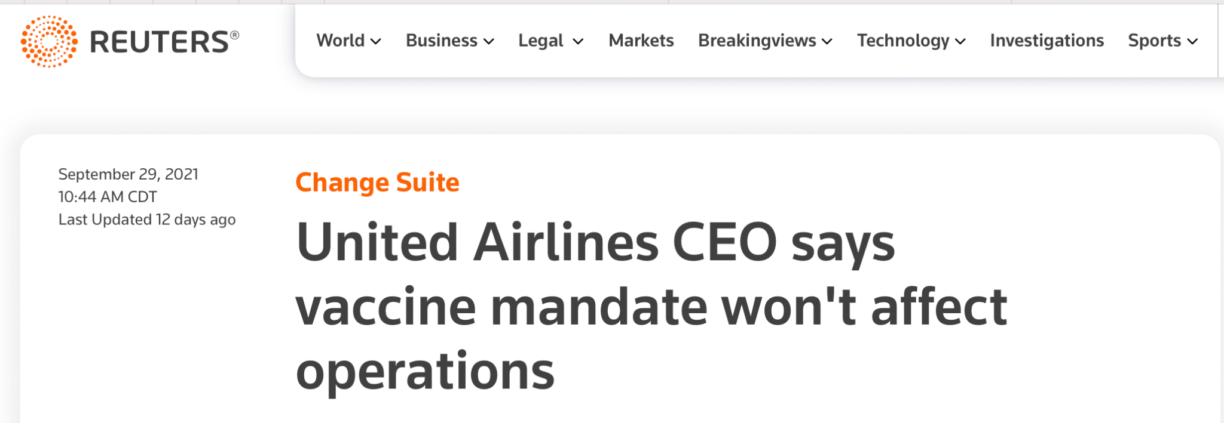
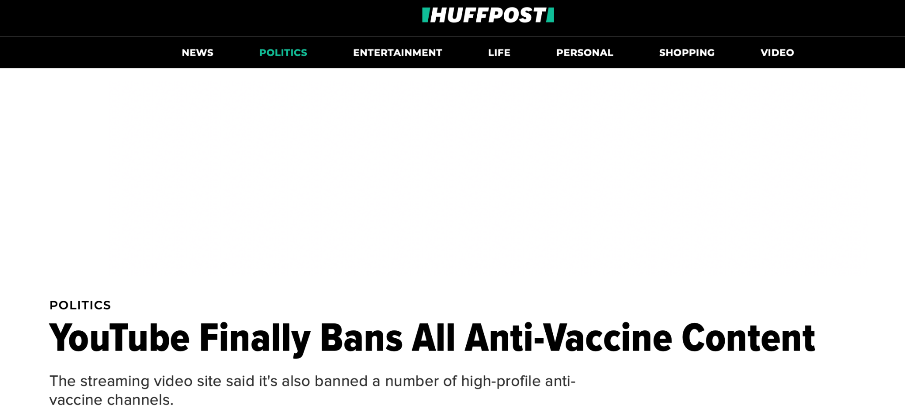
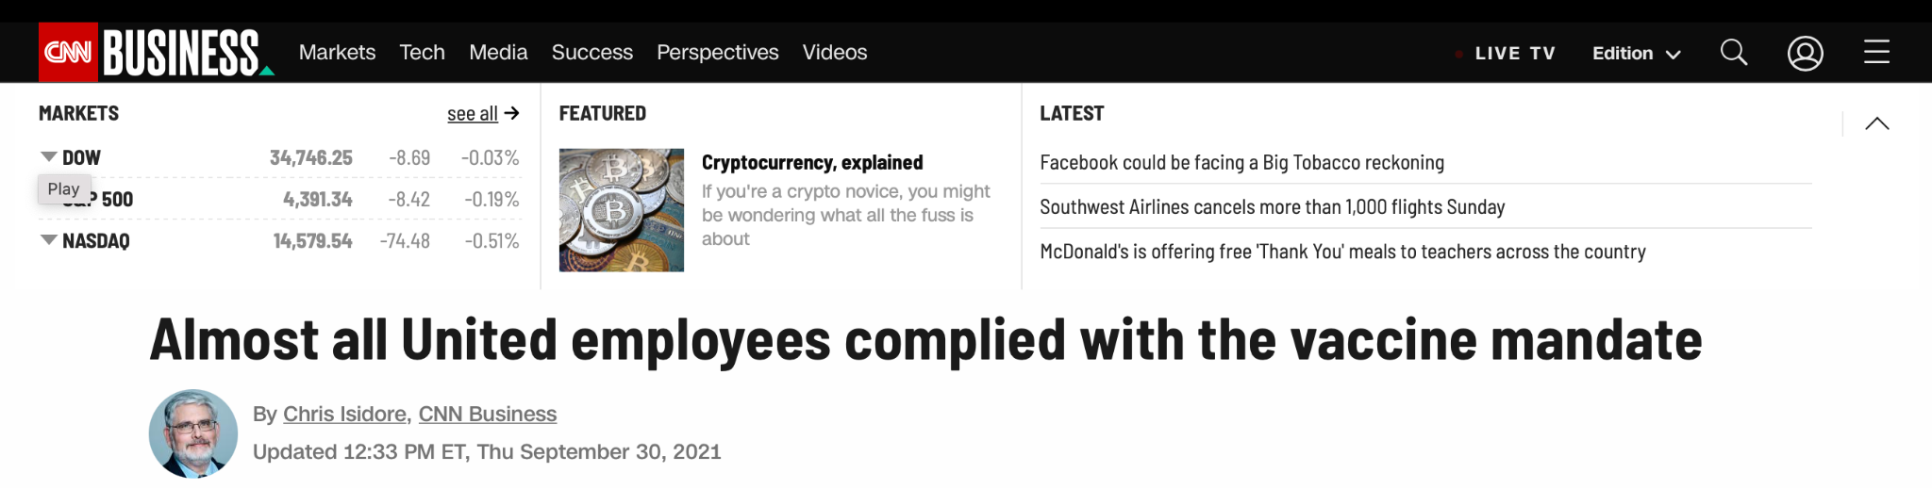
Data Sources: Articles
Notes:
Thanks Troy. To begin answering our question, we sought our data from 2 different online mediums. We started by scraping articles about the COVID-19 vaccine using the newspaper library. The vaccine was one of the most relevant and polarizing topics in US politics recently, and a widely covered topic in mainstream media. The vaccine presented the perfect gauge for political leaning with the assumption that pro vaccine stances are liberal and anti vaccine stances are conservative. We chose 5 different news outlets that varied across the political spectrum. From left to right, we chose Huffpost, CNN, Reuters, FoxNews, and Breitbart, and in total we gathered 66 articles.

Slide 6
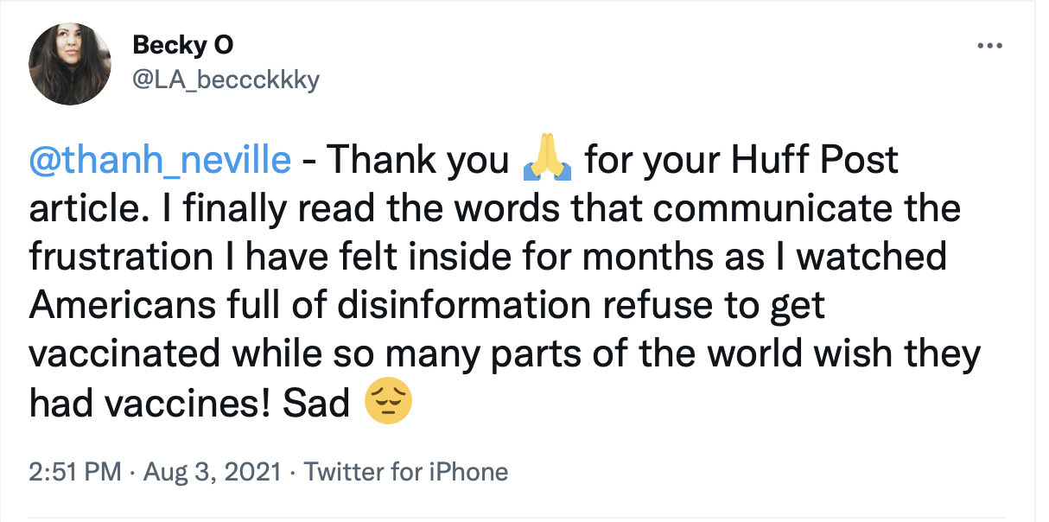
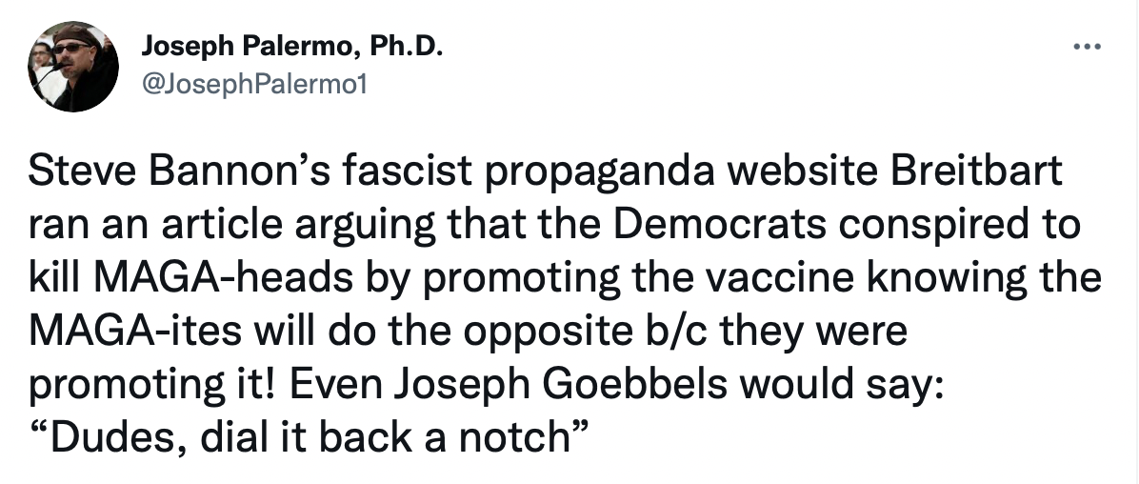
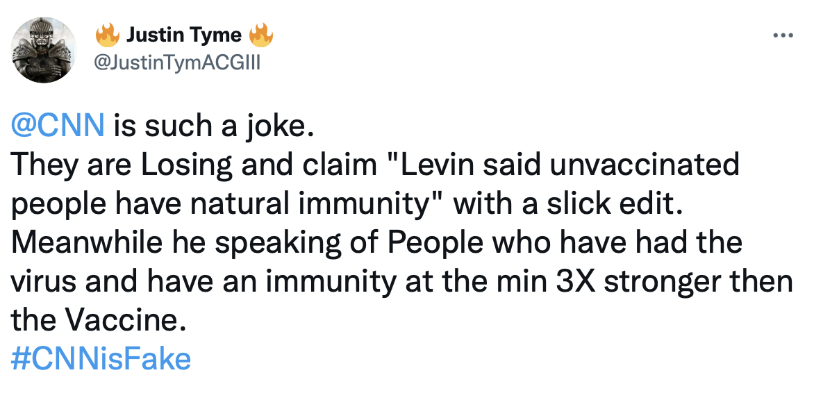
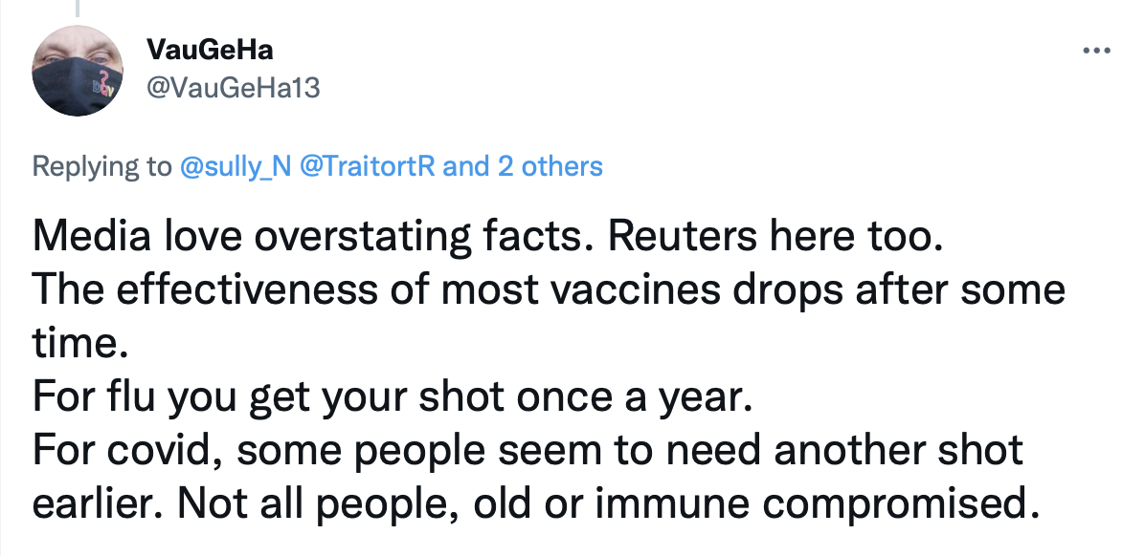
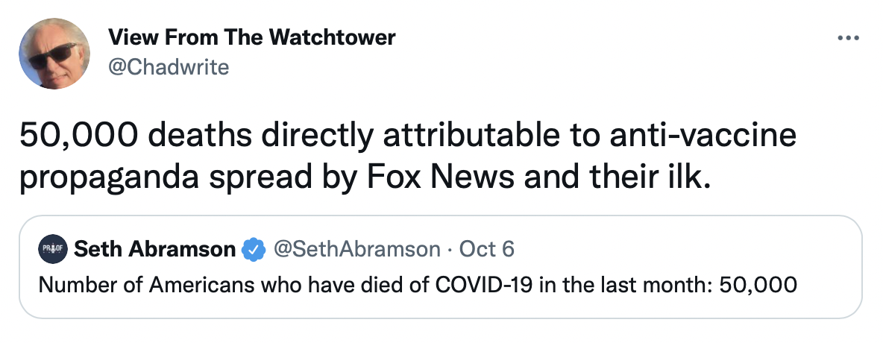
Data Sources: Twitter
Notes:
Next, we used Twitter. We scraped posts containing the names of our 5 publications as well as the specific word “vaccine” using tweepy, SnScrape and the twitter API. In total, we scraped around 7200 tweets. Additionally, we were able to obtain the location data of most of the users whose tweets we scraped.
Now here’s Akshat with our EDA.

Slide 7
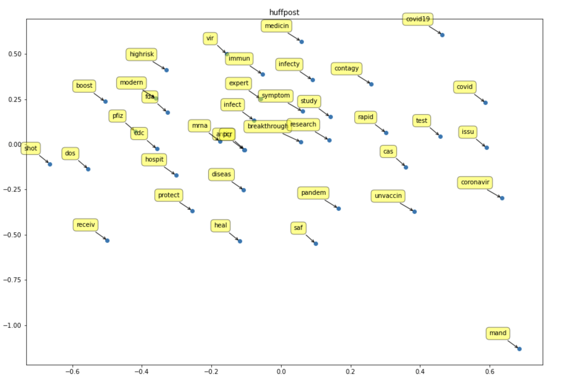
EDA: Huffington Post
Notes:
We used the NLTK library for preprocessing of this data. We stemmed the words using the Lancaster Stemmer, and isolated keywords based on frequency counts and relevance to the topic at hand.

Slide 8
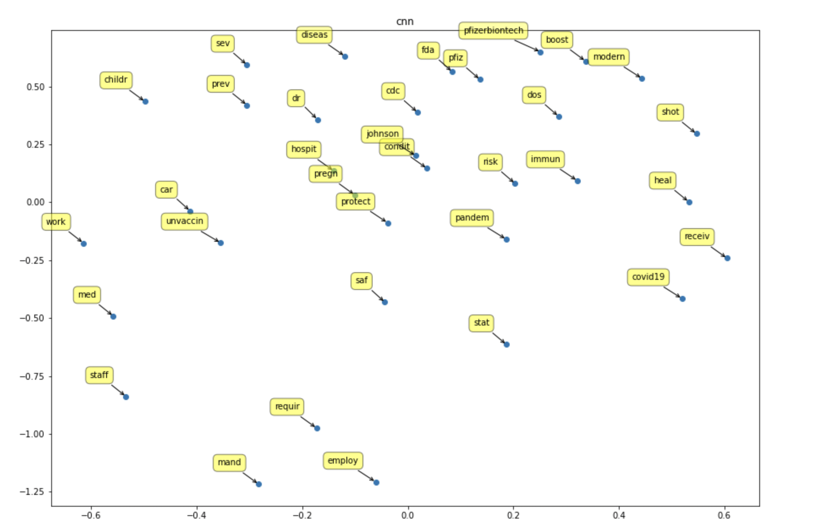
EDA: CNN

Slide 9
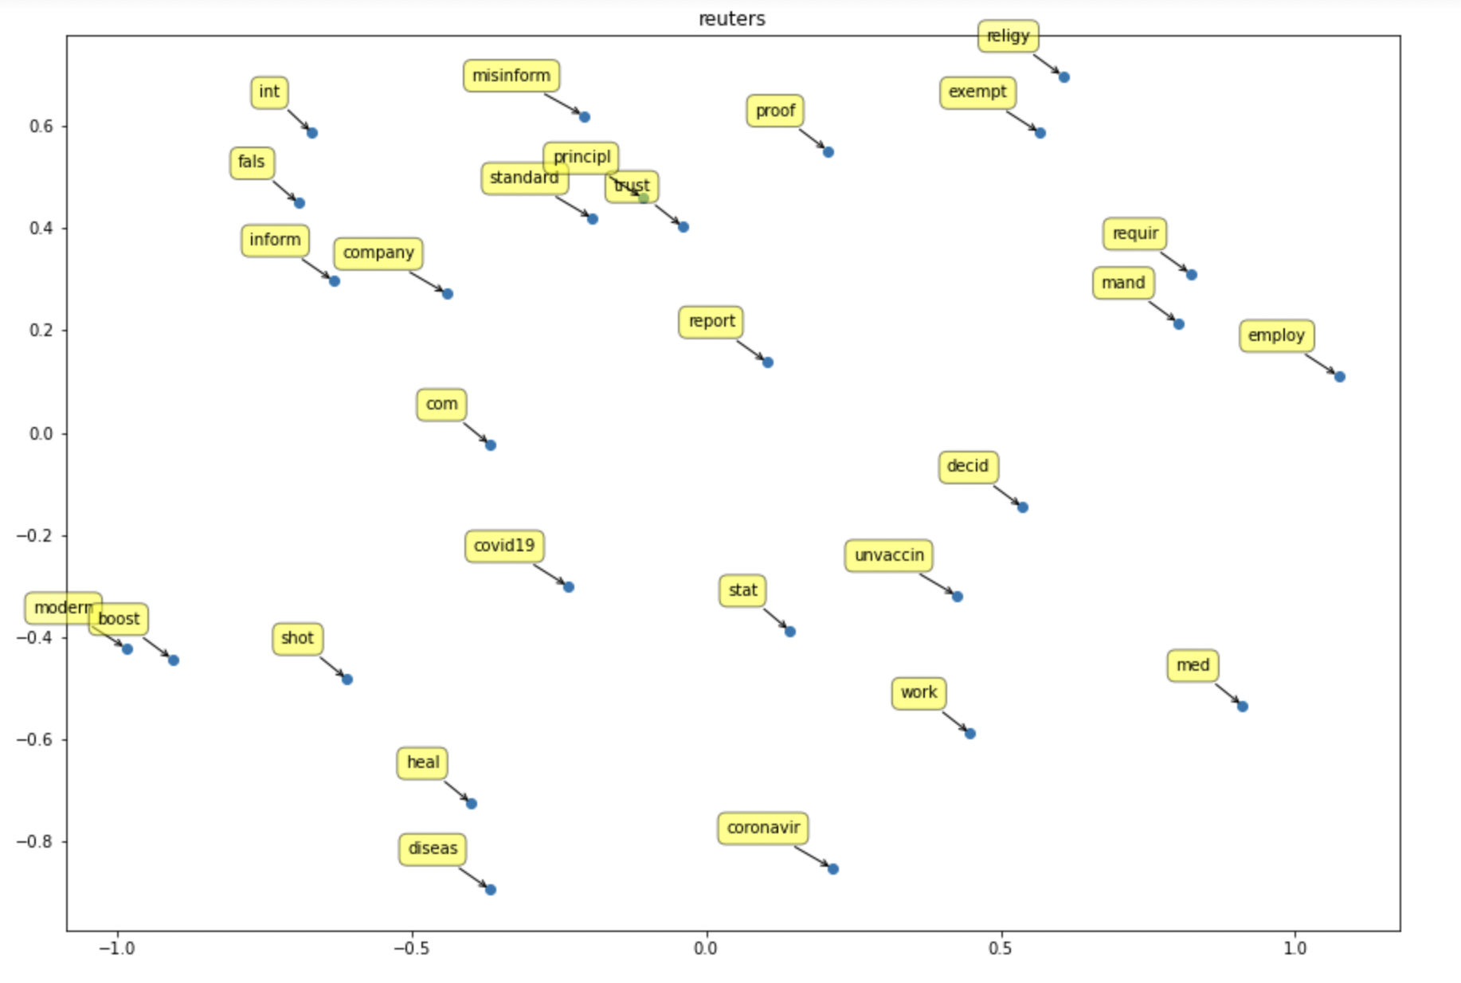
EDA: Reuters
Notes:
Reuters - Words are relatively spread out, showing that there is a lower association between most words and indicative of low bias

Slide 10
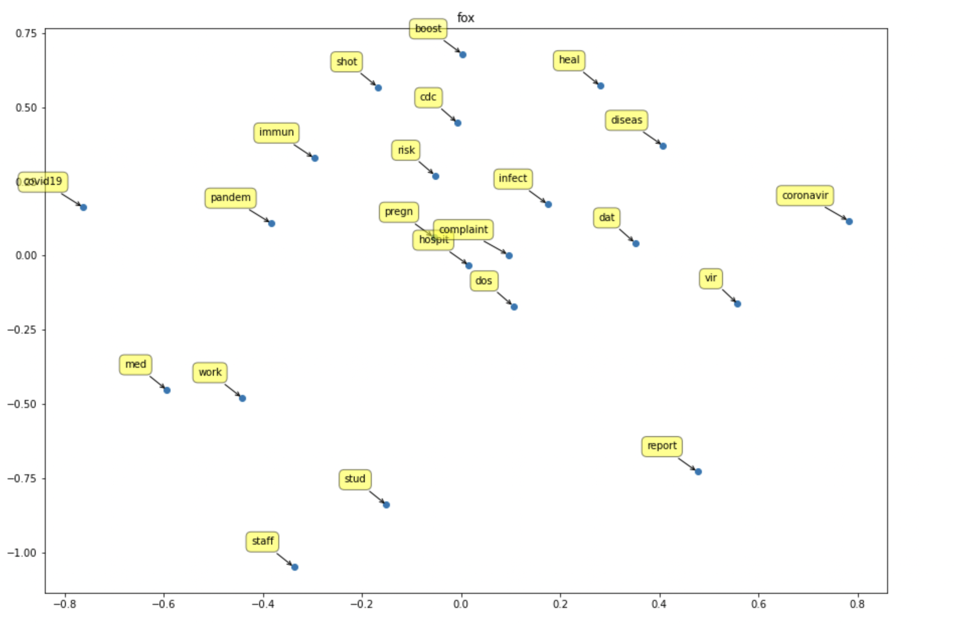
EDA: Fox

Slide 11
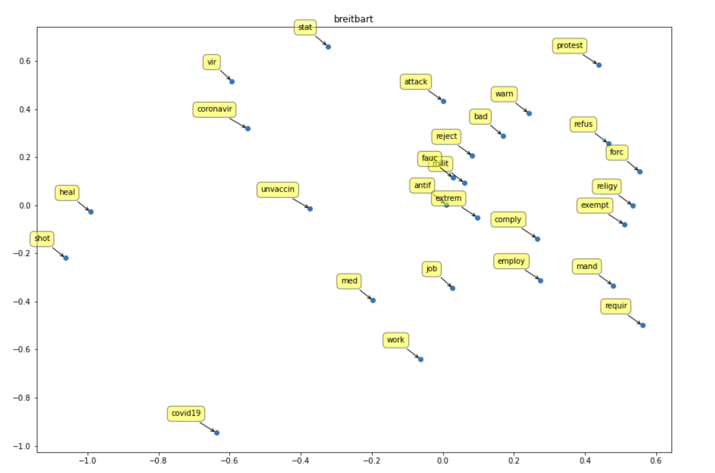
EDA: Breitbart

Slide 12
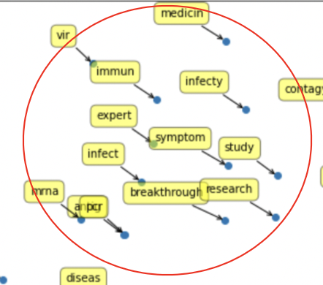
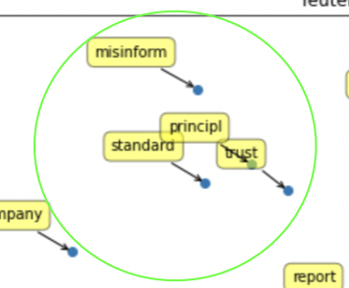
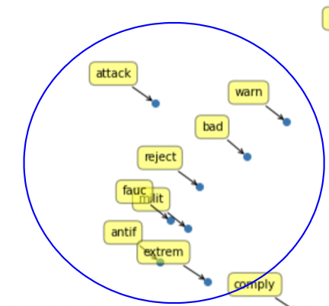
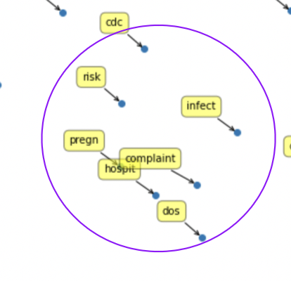
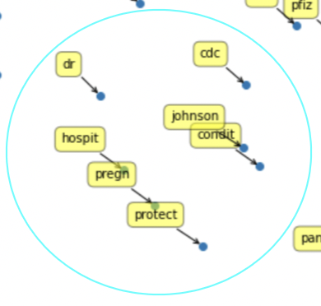
EDA: Summary
Huff Post: Science of Vaccine
Reuters: Reporting on Vaccine
Breitbart: Anti-vaccine
L
R
CNN: Importance of Vaccine
Fox: Dangers of Vaccine
Notes:
As you can see for HuffPo - Most words are bunched close together around science of the vaccine
Reuters - Reporting on vax
Breitbart - Antifa and anti-vax
Fox - Dangers of vaccine
CNN - Importance of vaccine

Slide 13
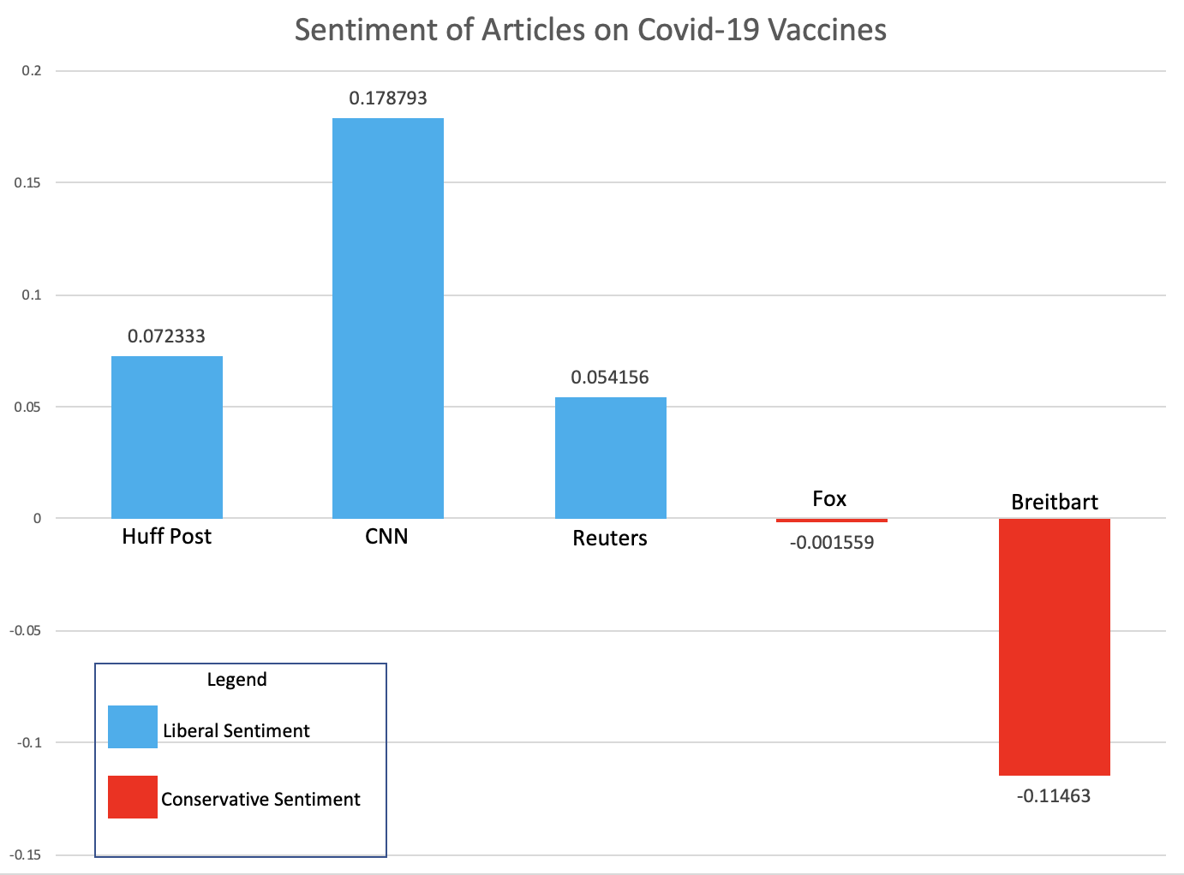
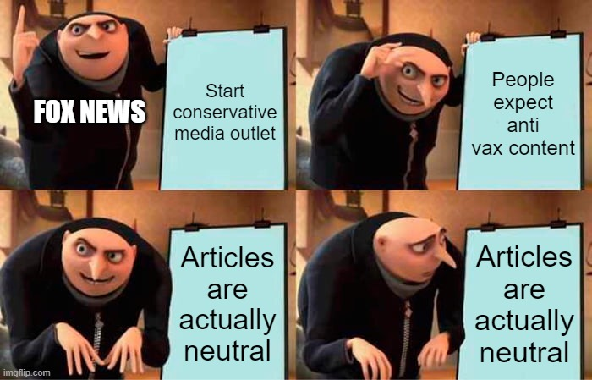
Analysis: Articles
Notes:
We did a sentiment analysis of the articles we scraped from each publisher. As you can see, Breitbart has by far the most conservative coverage of the vaccine while CNN had the most liberal coverage.. Fox seemingly reported on the negative topics found in our EDA in a relatively neutral manner. Reuters maintained its neutrality in its coverage. Huffpost leans slightly liberal in its coverage of the vaccine.

Slide 14
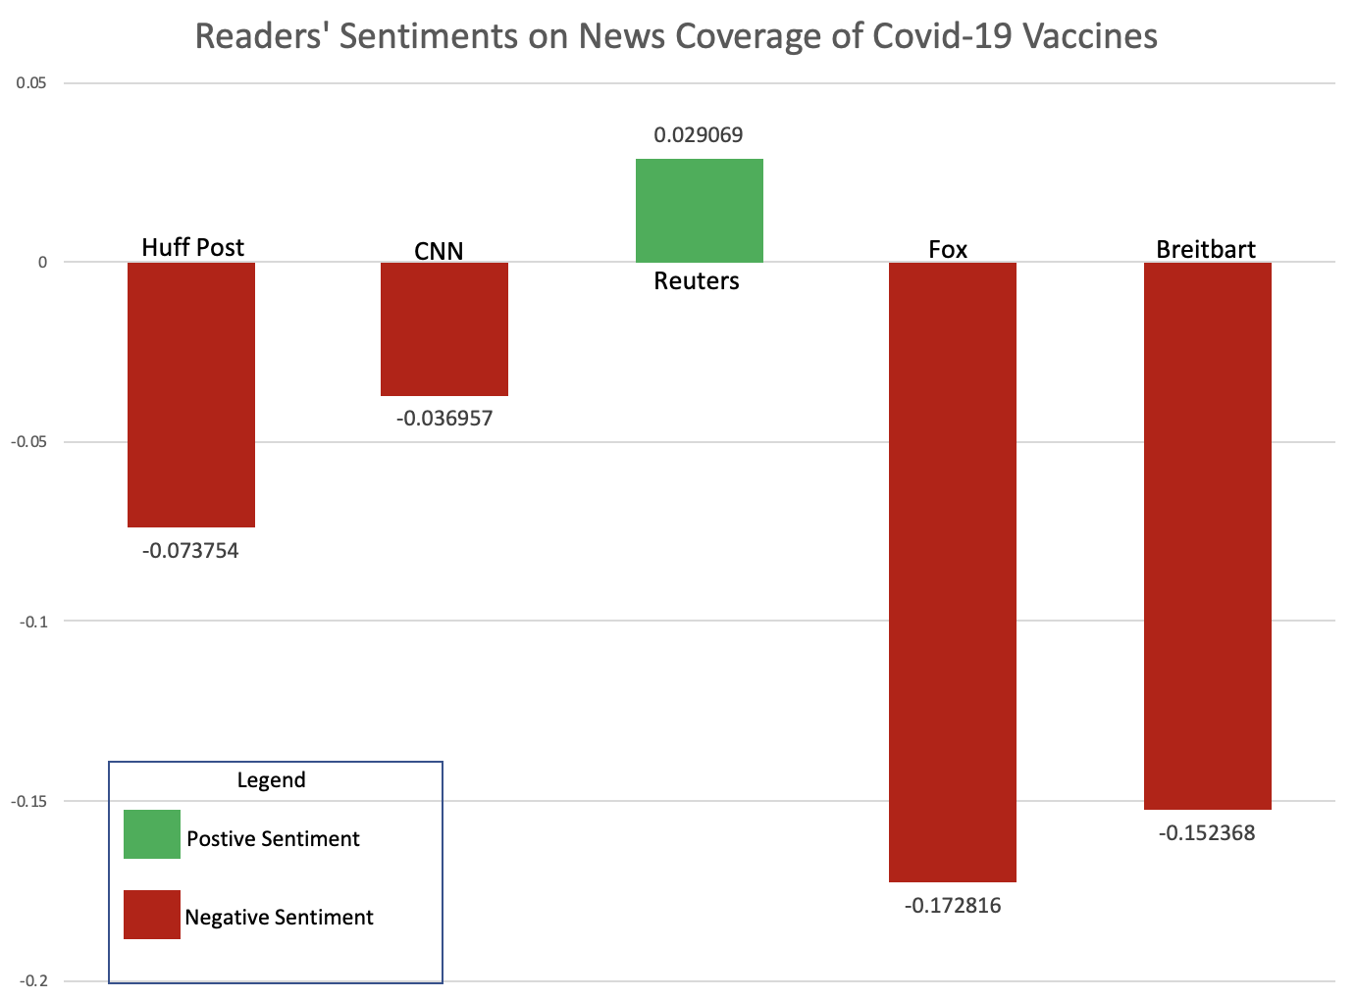
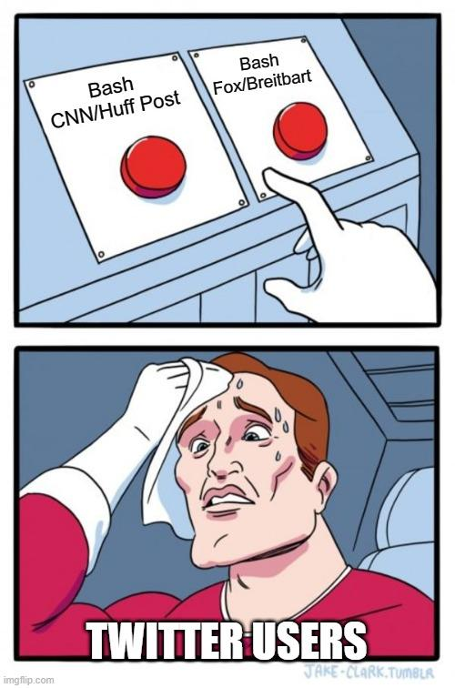
Analysis: Twitter Responses
Notes:
Users are generally always against publications that have some form of sentiment, for or against the vaccine. They all positively interpret Reuters, which is neutral.

Slide 15
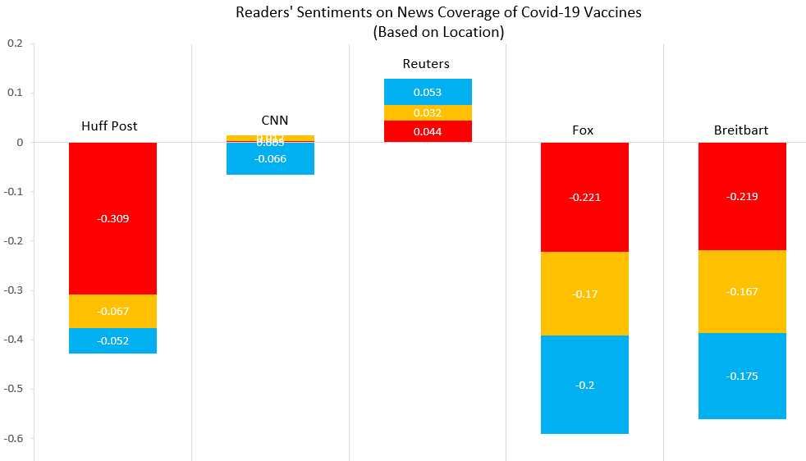

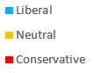
Analysis: Location Interaction
Notes:
Huff Post is negatively perceived by conservatives. Fox and Breitbart and negatively perceived by all, irrespective of their inclination.

Slide 16

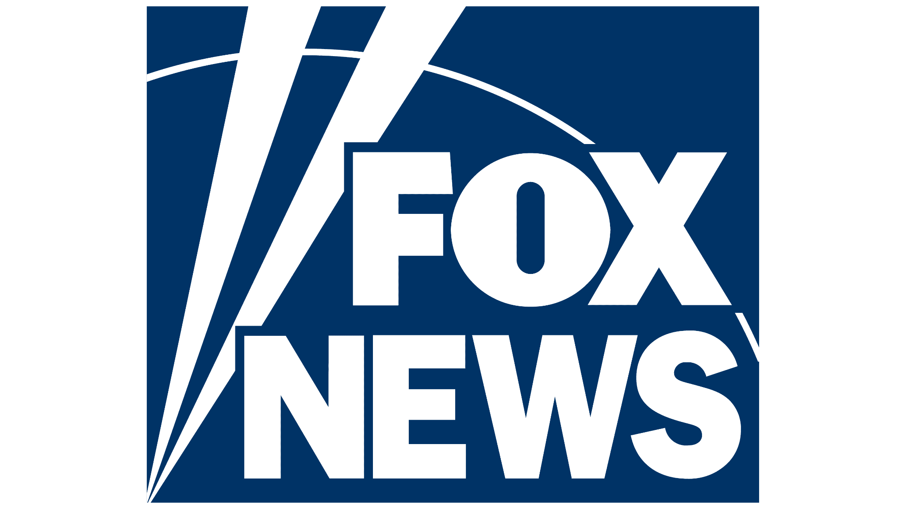

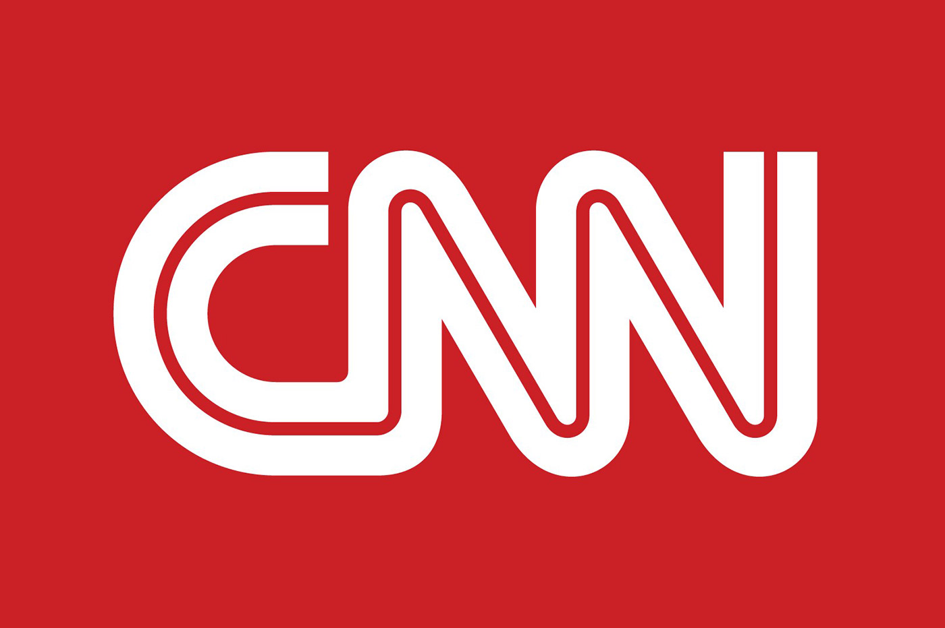


Insight
Articles:
L
R
Tweets:
L
R
Notes:
Through scraping articles and performing sentiment analysis as previously described, we saw that CNN actually had the most positive attitude towards vaccines, while Breitbart had the most negative. A key takeaway is that Fox News is reporting about vaccines in a relatively neutral manner. Reuters had been consistently neutral in it’s coverage about the vaccine.
Regarding the reader conversations around vaccine coverage:
Liberals and Conservatives are very polarized about the coverage by HuffPo, with liberals appreciating their coverage while cons are strongly against it.
Popular opinion is that the news sources that are perceived as more biased are not as appreciated as the more neutral sources. I. Fox, Breitbart and HuffPo are looked down upon whereas CNN and Reuters are favoured.
Liberals are also strongly against the vaccine coverage by Fox and Breitbart, whereas Conservatives are somewhere in the middle. There are a couple of explanations that can account for this:
Strong Conservatives may view Fox and Breitbart’s vaccine coverage as insufficiently negative or
Given the method in which we determined Conservative tweets, we could have tagged liberals criticizing these sources that reside in Conservative states as conservatives themselves rather than true liberals. (False Positives)

Slide 17
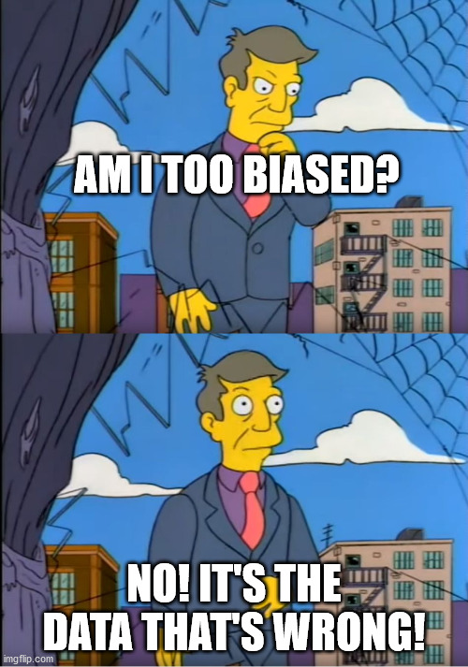
Thank You! Any Questions?

